Slide 1


Slide 2


Slide 3
PURPOSE
THE PURPOSE OF THIS PROJECT IS TO GIVE RELEVANT INFORMATION TO HIGH CLOUD AIRLINES WHICH COULD HELP THEM IN MAKING DATA DRIVEN DECISIONS TO IMPROVE OPERATIONAL EFFECIENCY AND PROFITABILITY.

Slide 4
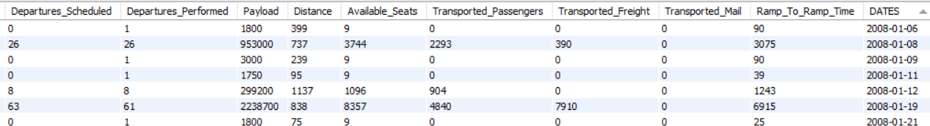


DIFFICULTIES
UNITS OF MEASUREMENTS
DATA REDUNDENCY
DATA VOLUME

Slide 5
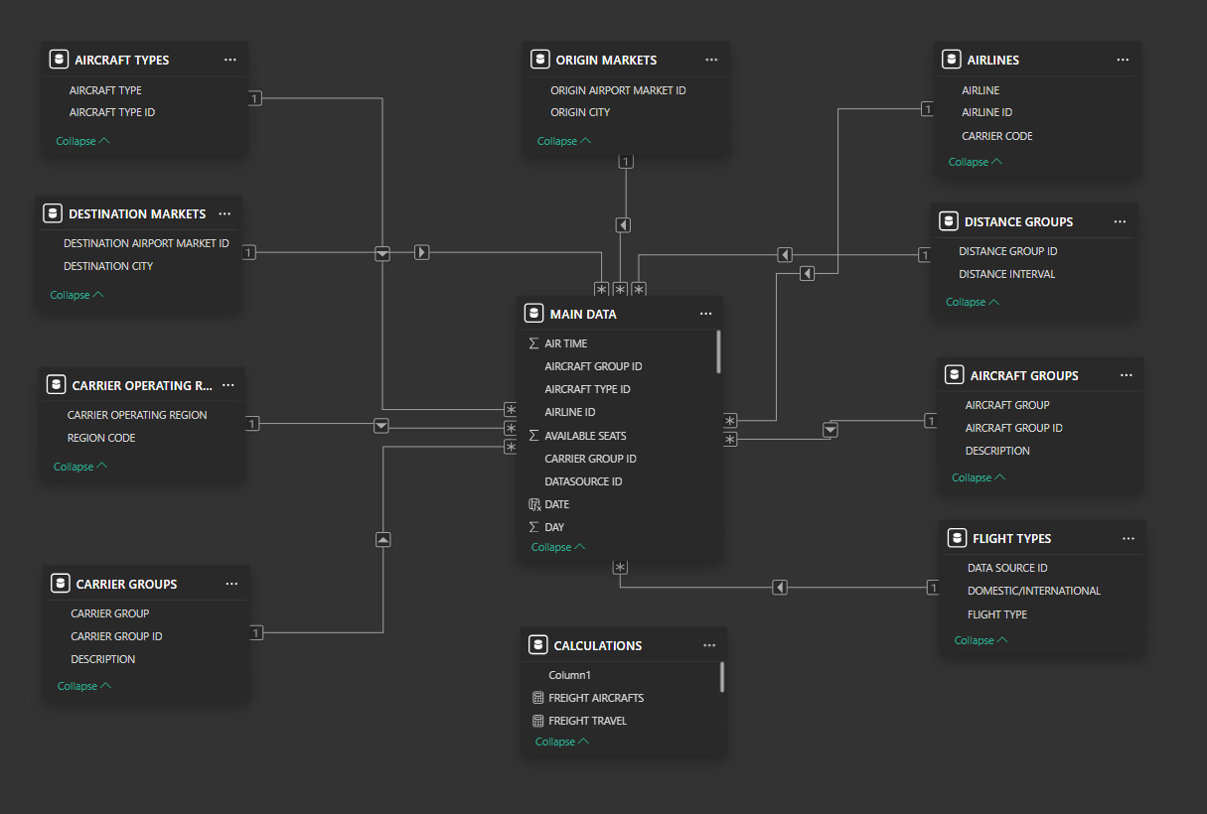
DATA MODELLING

Slide 6
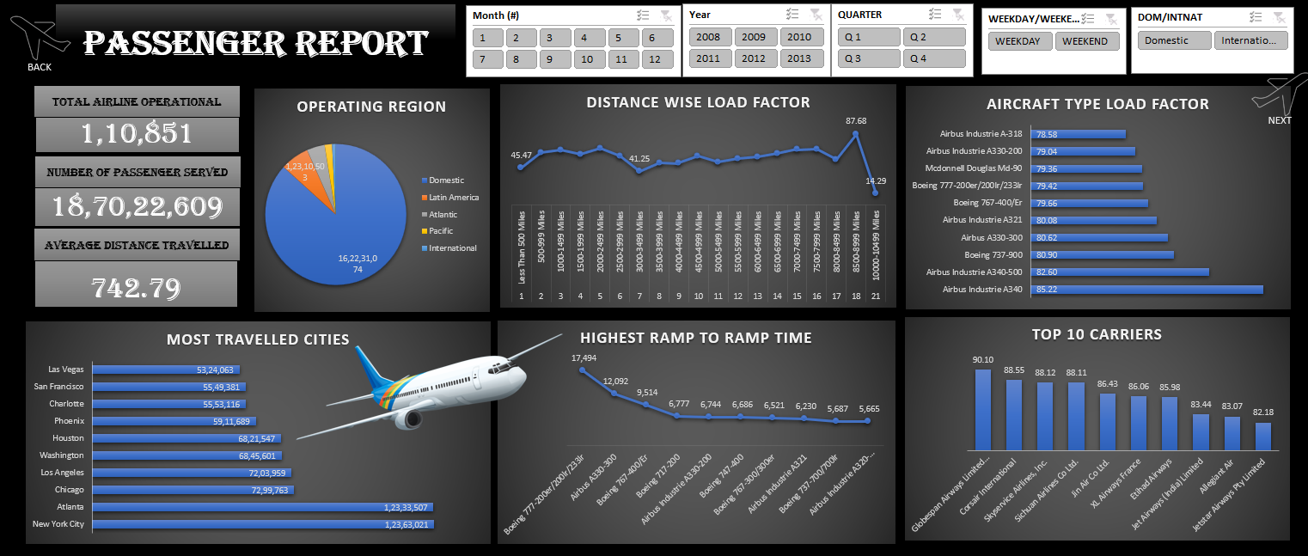

Slide 7
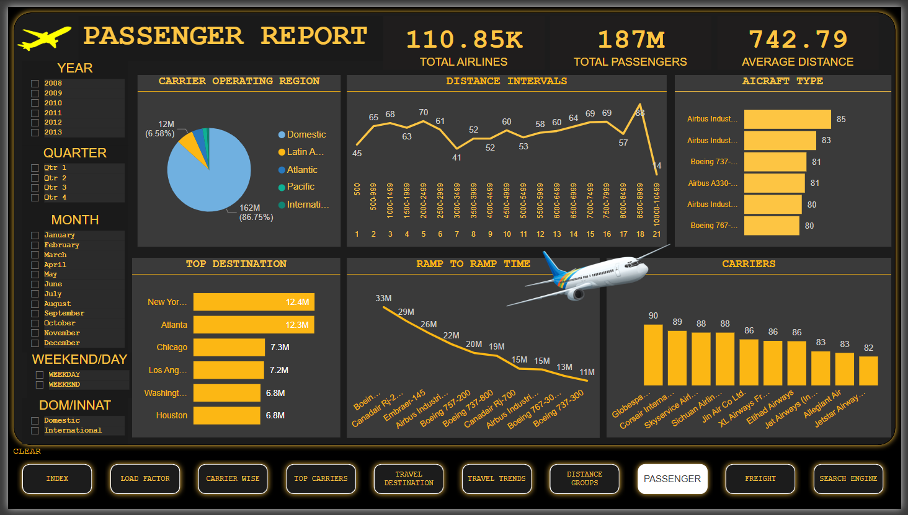

Slide 8
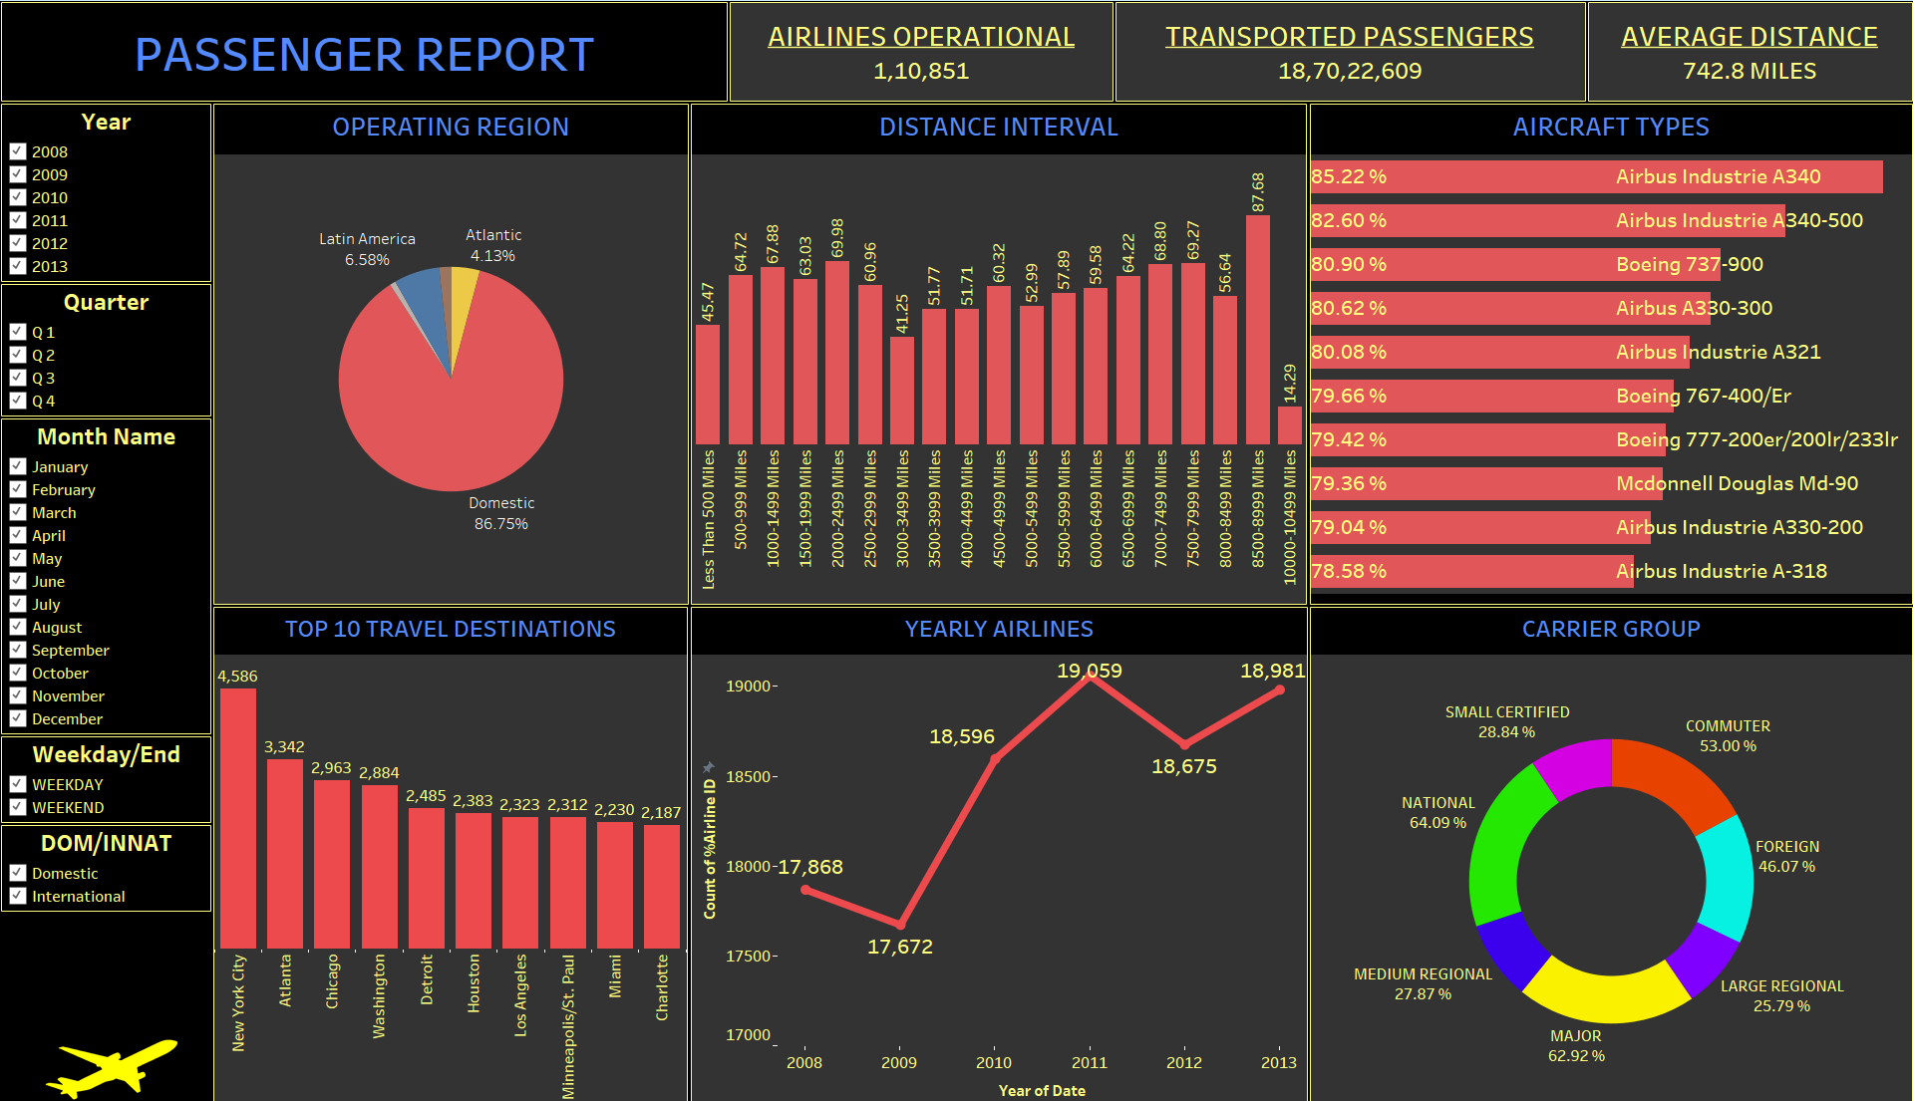

Slide 9
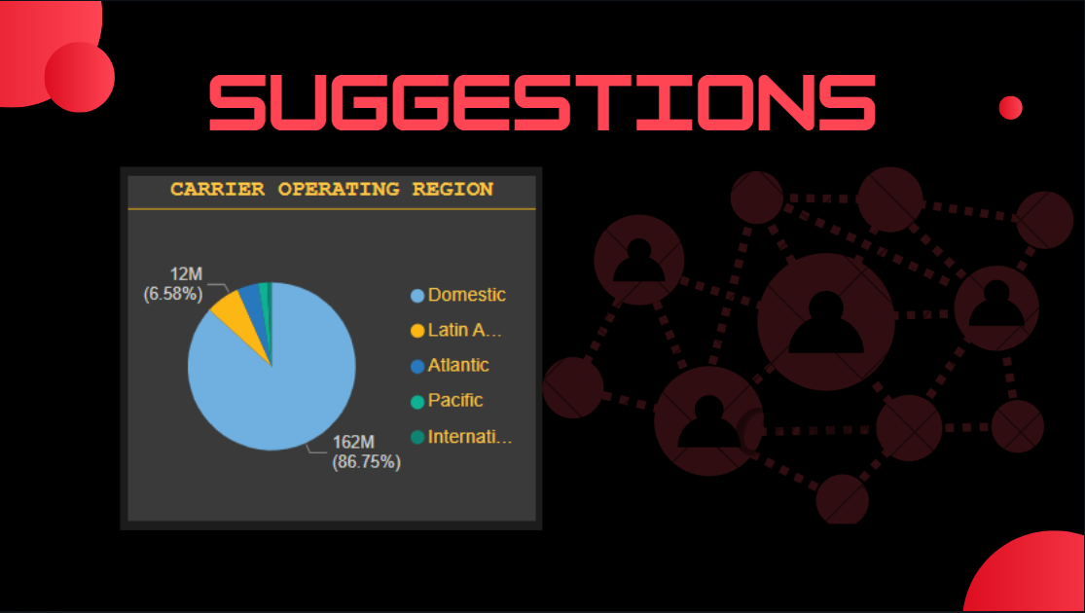

Slide 10
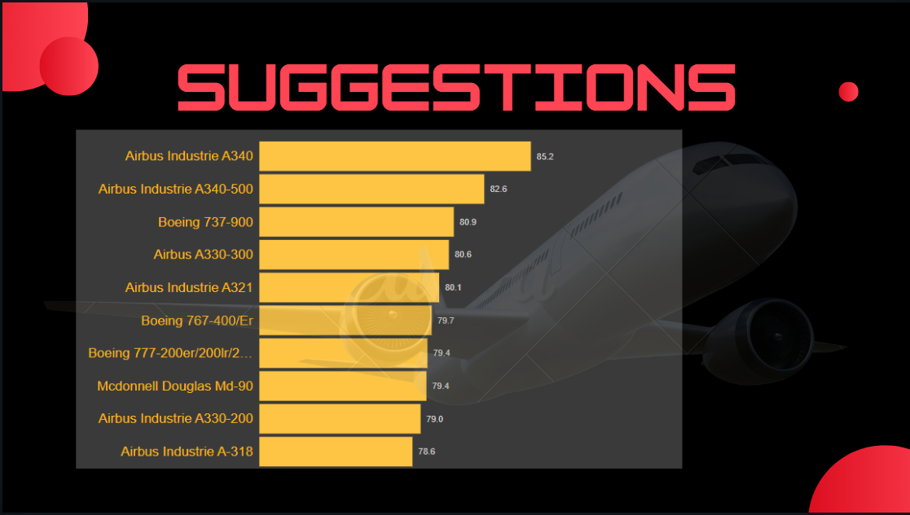

Slide 11
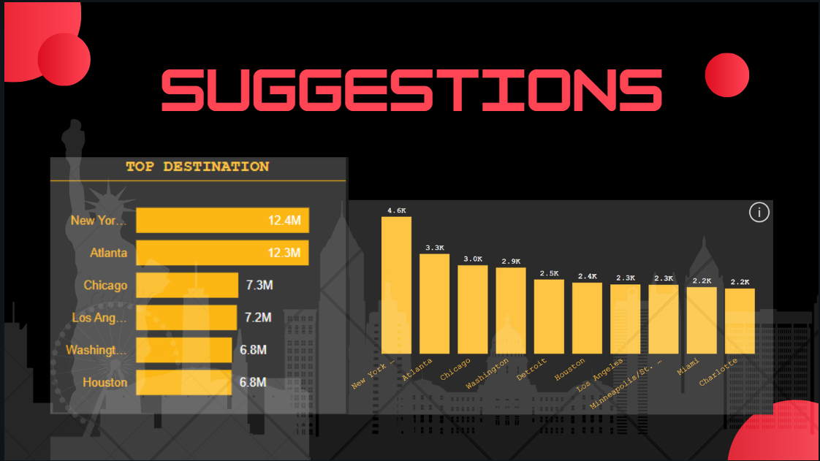

Slide 12


